Slide 1

Algorithms and Data Structures 1 CS 0445
Fall 2023
More Recursion Examples
Sherif Khattab
ksm73@pitt.edu
(Slides are adapted from Dr. Ramirez’s and Dr. Farnan’s CS1501 slides.)

Slide 2
Announcements
Upcoming Deadlines:
Programming Assignment 2: Friday 10/20 @ 11:59 pm
Homework 7: Tuesday 10/17 @ 11:59 pm
Lost points in a lab assignment because of the autograder or a simple mistake?
please reach out to Grader TA over Piazza
OMET Midterm Survey Results
Slowing down
Live coding

Slide 3
A Recipe for Designing Recursive Solutions
Define the problem at hand
What are the input(s) and output(s)
Find a Base Case:
What is an input that you can solve yourself
without asking for friends’ help
Define a Recursive Case:
Imagine a friend who can solve the problem at hand
You can’t ask them for help with the original problem
Find one or more smaller problems (subproblems) to ask your friend to solve
Given your friend’s solutions, how can you solve the original problem?
Revisit the inputs to the problem given what your friend needs to define subproblem

Slide 4
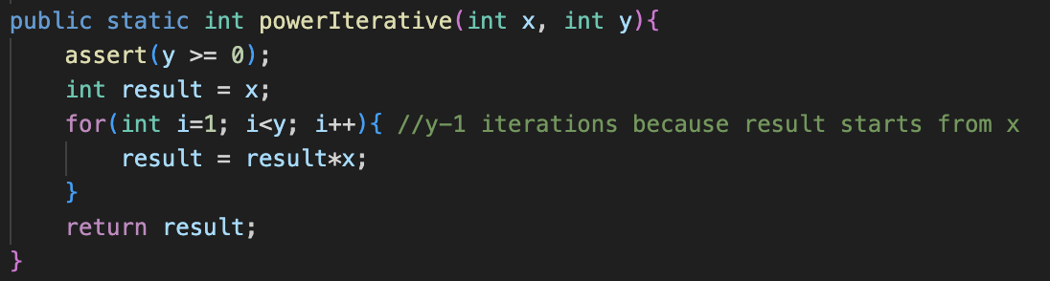
Computing x^{y}
Using iteration

Slide 5
Computing x^{y}
What is the running time of powerIterative?
O(y)

Slide 6
Computing x^{y} using Recursion
Base (non-recursive) case
x⁰ = 1
Recursive case
You have a friend who can compute x^{y}
x^{y} = x^{y/2} * x^{y/2}
when y is even
what if y is odd?
y/2 is an integer division
x^{y} = x^{y/2} * x^{y/2} * x
when y is odd

Slide 7
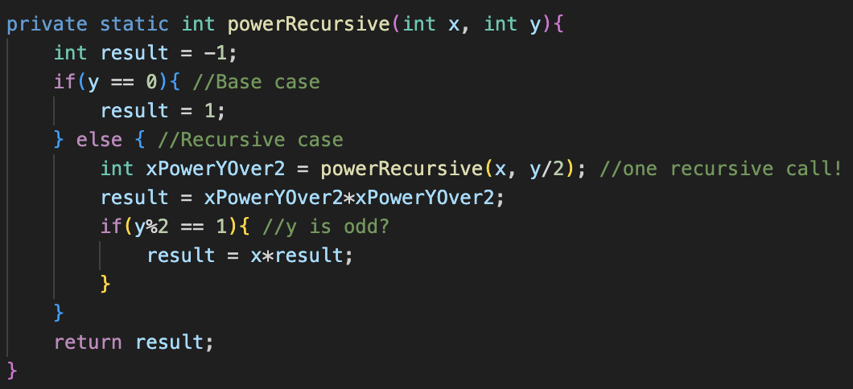
Computing x^{y} Recursively

Slide 8
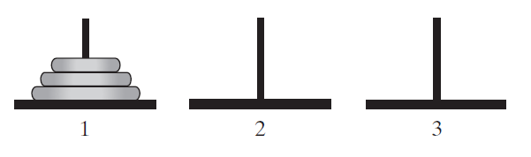
Towers of Hanoi
The initial configuration of the Towers of Hanoi for three disks.

Slide 9
Towers of Hanoi Problem
Goal: Move disks from pole 1 to pole 3
Rules:
Move one disk at a time.
Moved Disk must be topmost
No disk may rest on top of a smaller disk

Slide 10
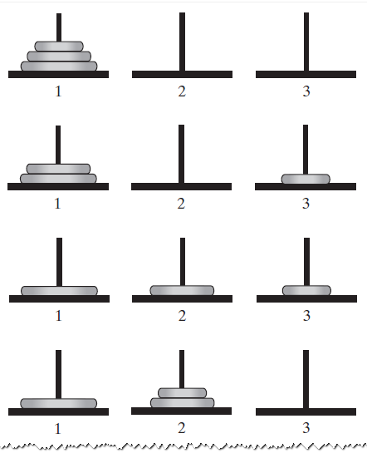
Solution of Towers of Hanoi with three disks
The sequence of moves for solving the Towers of Hanoi problem with three disks

Slide 11
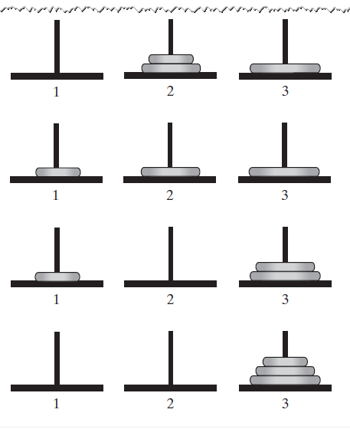
Solution of Towers of Hanoi with three disks (contd.)
The sequence of moves for solving the Towers of Hanoi problem with three disks

Slide 12
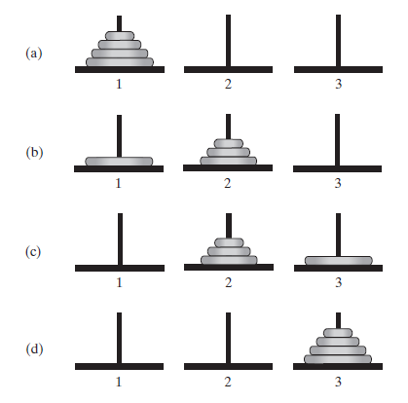
Deriving Recursive Case
Imagine a friend who can move disks from one pole to another
We are given four disks to move from Pole 1 to Pole 3

Slide 13
Recursive Case Derivation
Ask our friend to move three disks from Pole 1 to Pole 2
Move one disk ourselves from Pole 1 to Pole 3
Ask our friend to move three disks from Pole 2 to Pole 3

Slide 14
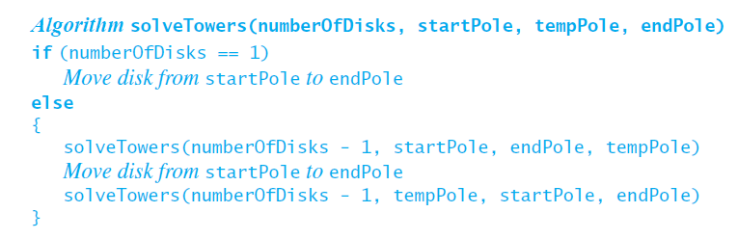
Towers of Hanoi: Recursive algorithm

Slide 15
Reversing a Linked List Recursively
You have seen in recitations how to reverse a linked list iteratively
pretty much involved
Let’s try a recursive solution!
Imagine you have a friend who can reverse a linked list
You can use your friend’s help
But …
You can’t ask your friend to reverse the same list given to you
ask for help on a “smaller” list
Our friend is the recursive method after all!

Slide 16
Reversing a Linked List Recursively
Input: first node of list to reverse
Output: first node of reversed list
Base cases
reversing an empty or singleton list → return same list
Recursive case:
Keep track of the first node
Ask friend to reverse the rest of the list …
i.e., starting from second node
Attach the first node to last node of reversed sub-list
which node is last node of reversed list?
Yes! it is the second node in the original list
Remember we asked our first to reverse the sub-list starting from second node
Need to keep track of second node as well
Return the first node of reversed list
from our friend’s return value
Let’s code!

Slide 17
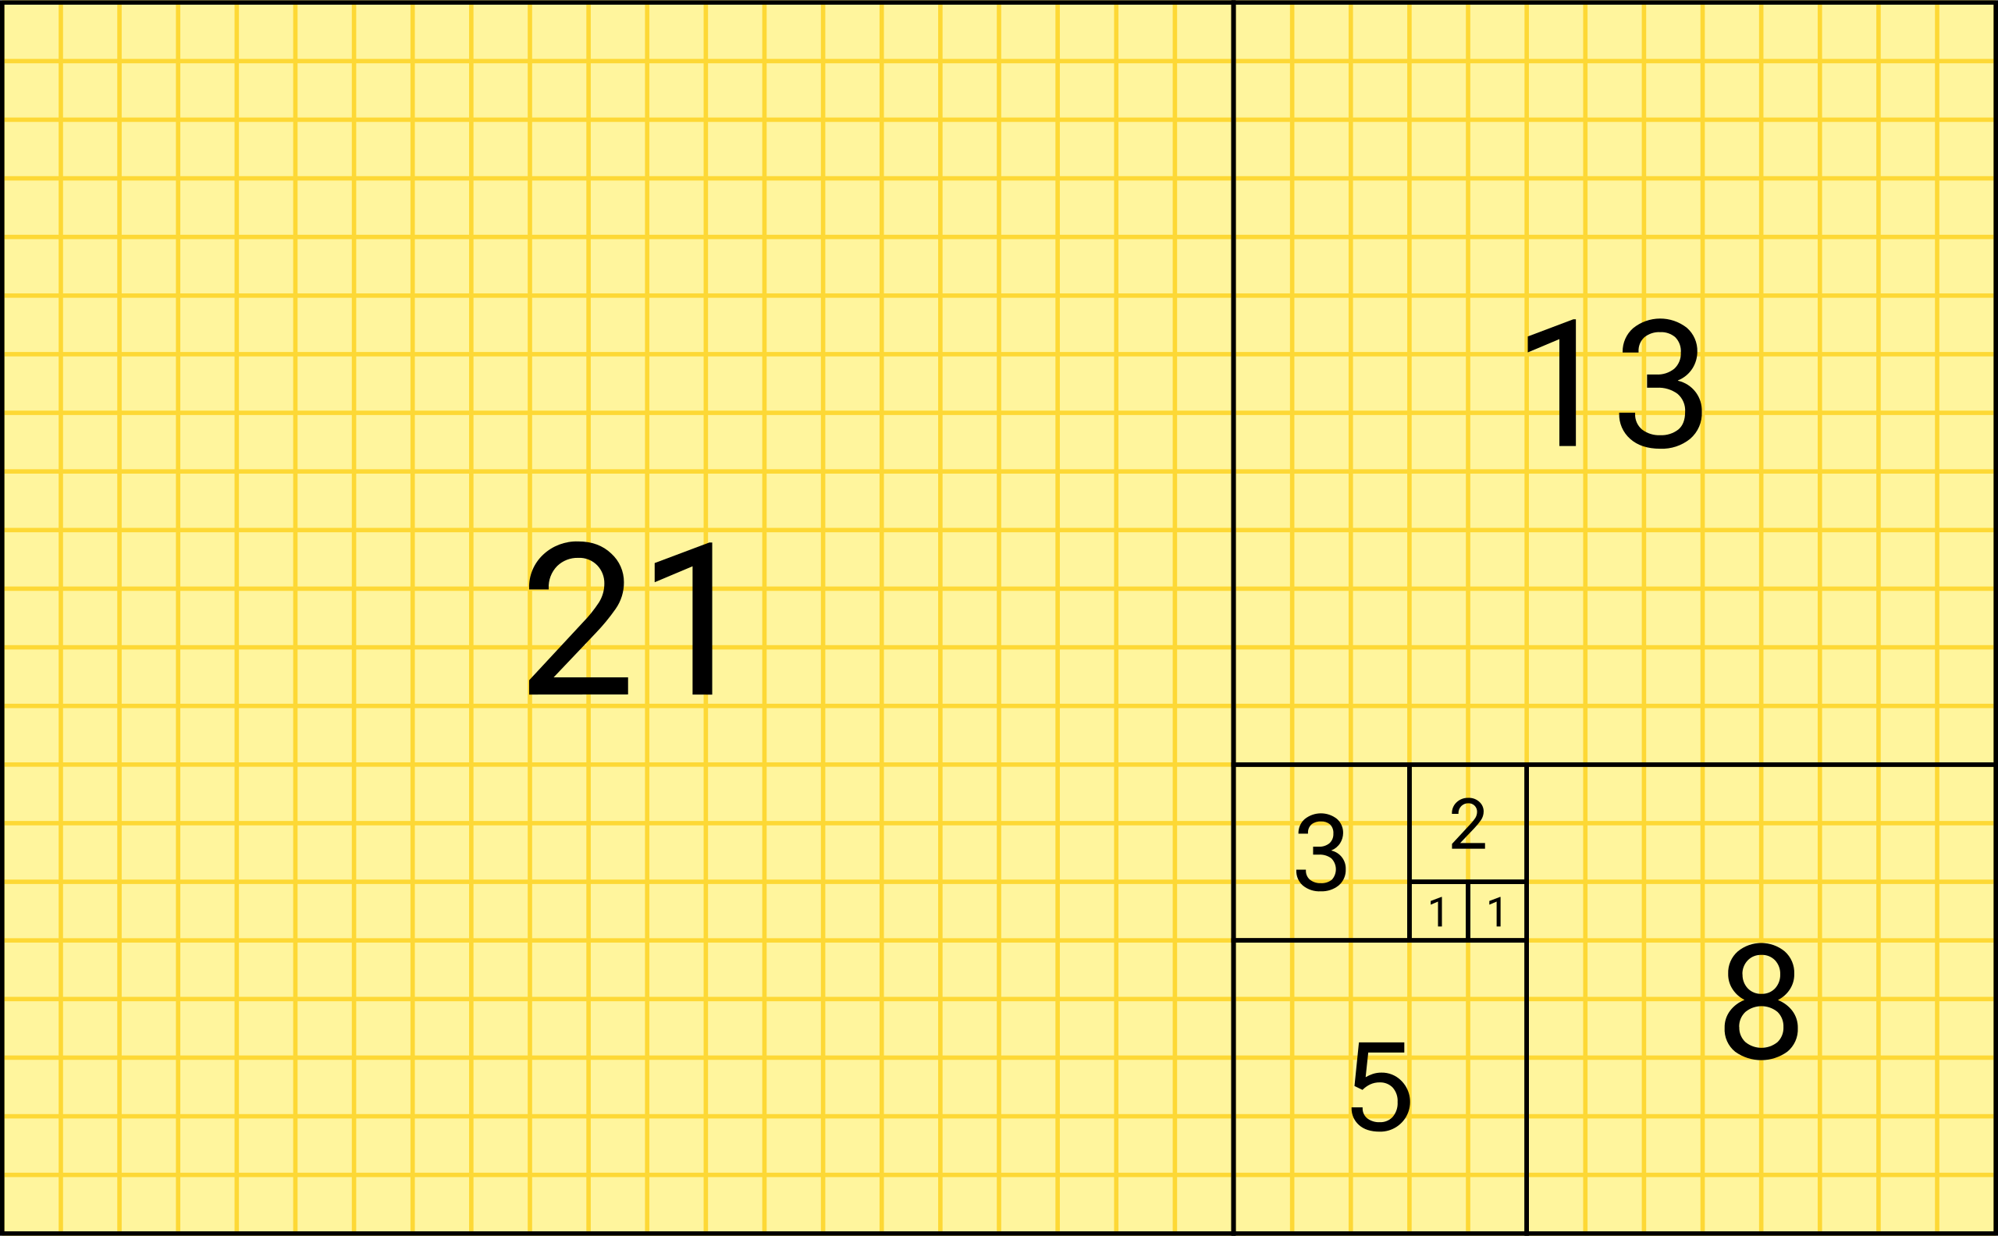
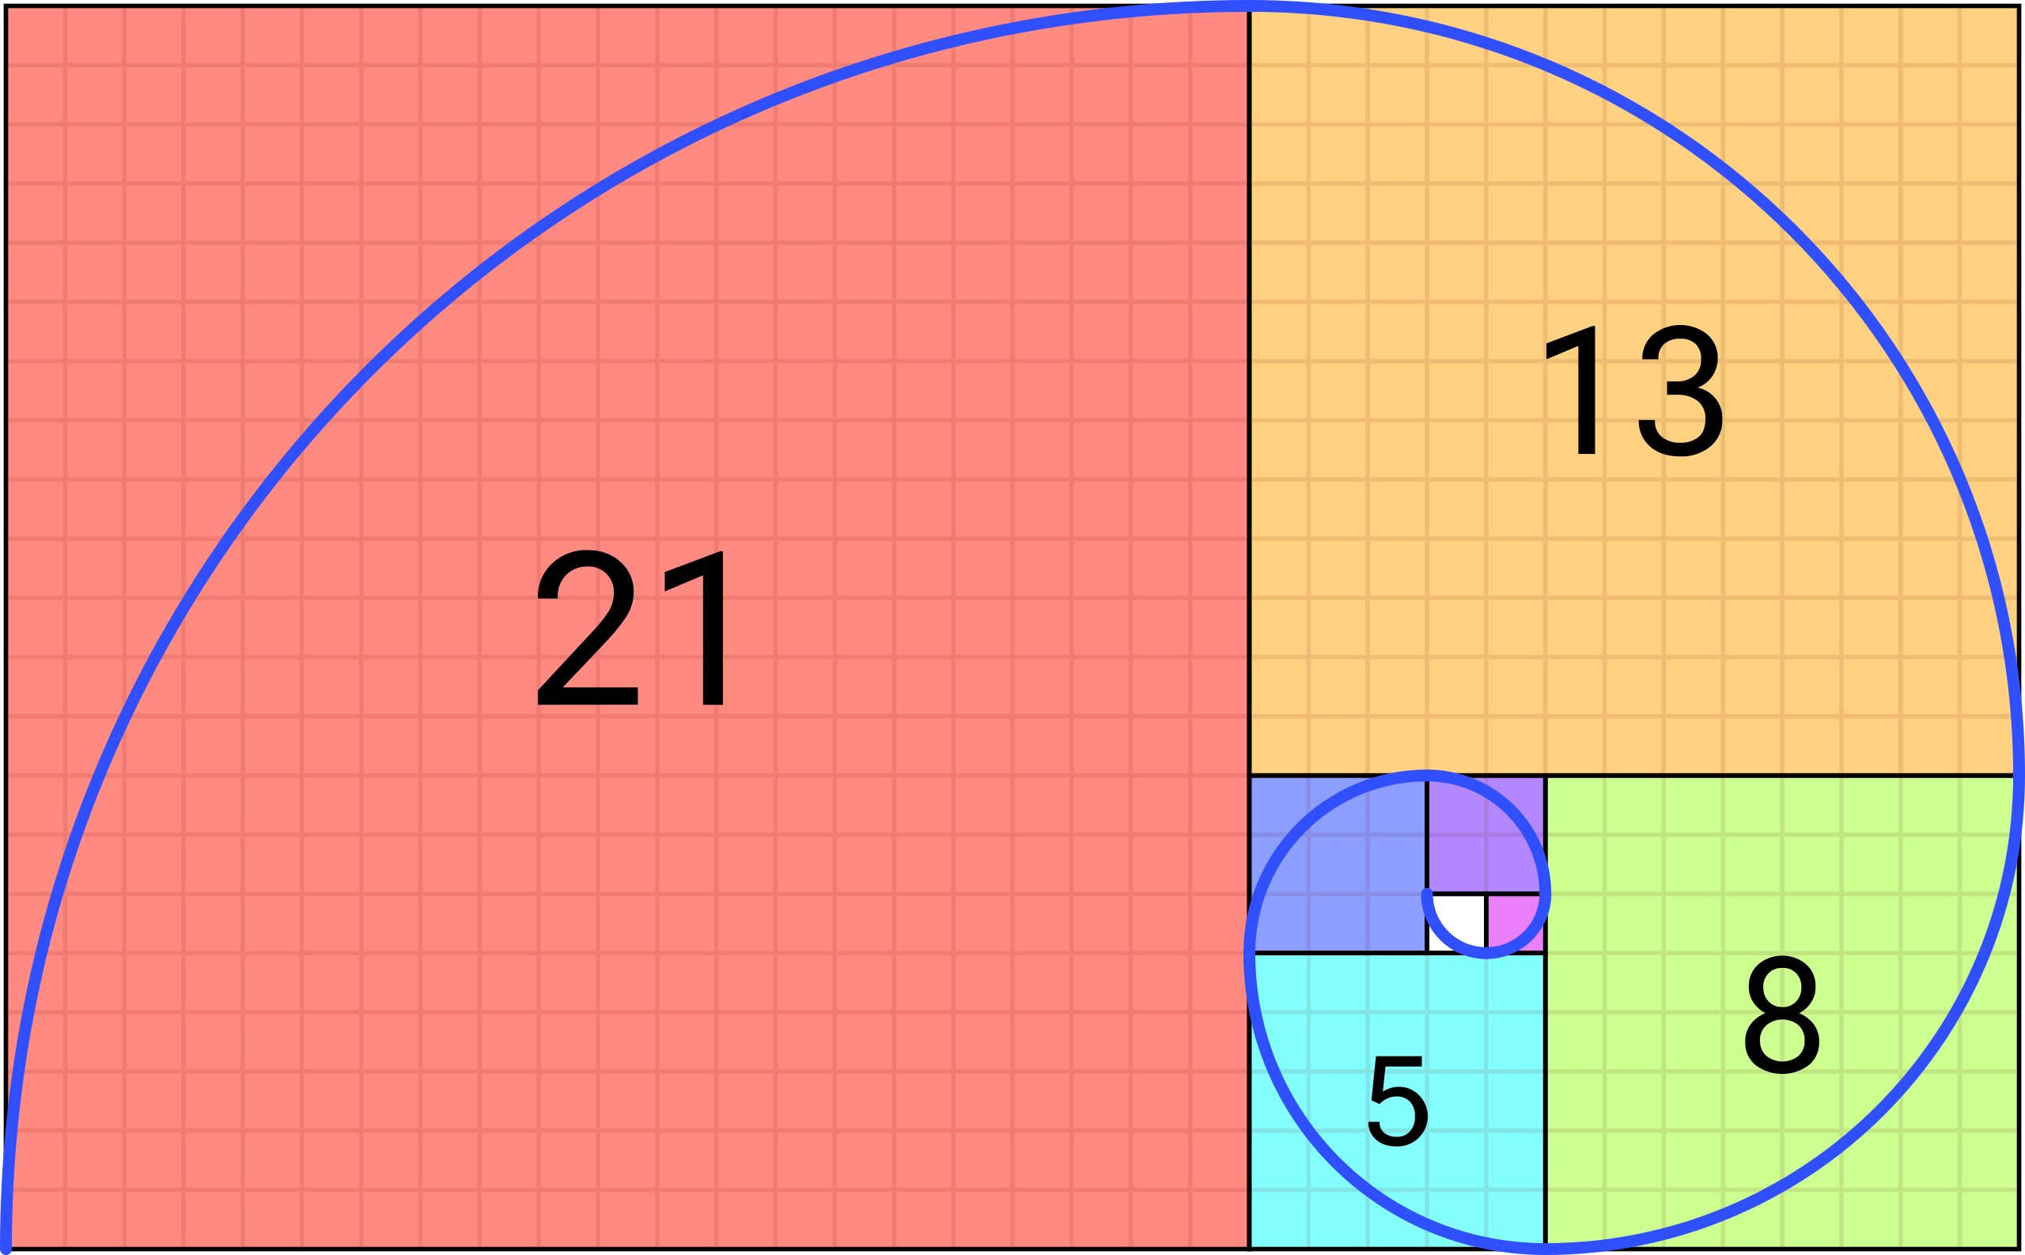
Generating Fibonacci Numbers
Fibonacci numbers:
1, 1, 2, 3, 5, 8, 13, 21, 34, 55, ….
Fibonacci number. (2022, October 13). In Wikipedia. https://en.wikipedia.org/wiki/Fibonacci_number
CC BY-SA 4.0

Slide 18
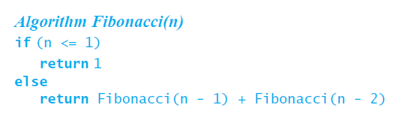
Generating Fibonacci Numbers
Fibonacci numbers:
1, 1, 2, 3, 5, 8, 13, 21, 34, 55, ….

Slide 19
Generating Fibonacci Numbers
Fibonacci numbers:
1, 1, 2, 3, 5, 8, 13, 21, 34, 55, ….
Double Recursion!

Slide 20
Single recursion
A recursive algorithm with a single recursive call provides a linear chain of calls
Calls build run-time stack
Stack shrinks as calls finish

Slide 21
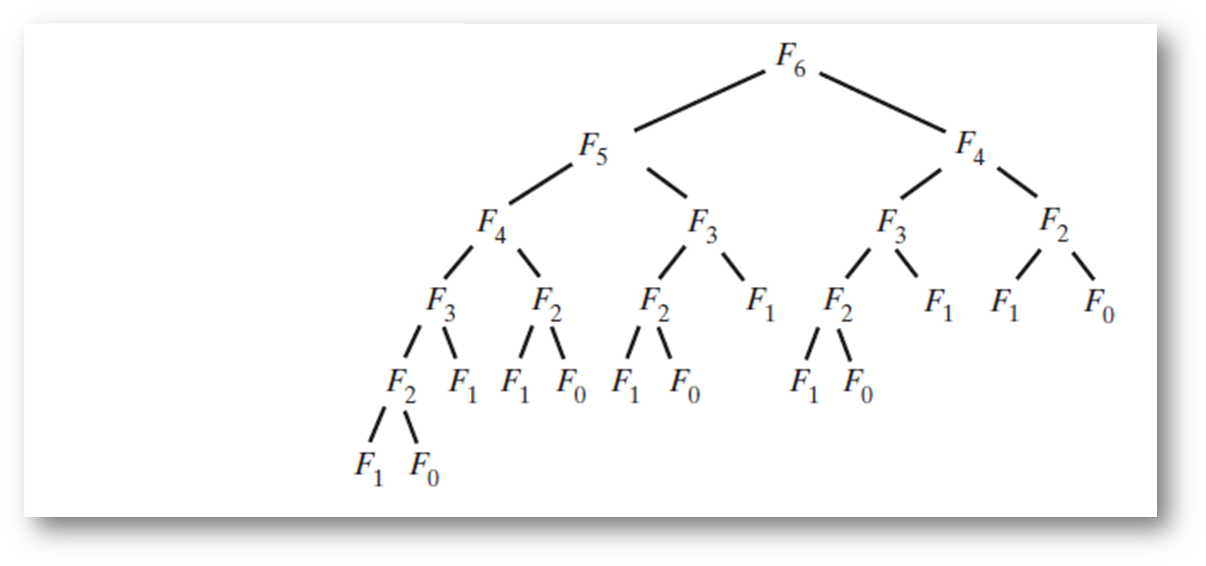
Double Recursion
The computation of the Fibonacci number F₆ using recursion

Slide 22
Double Recursion
The computation of the Fibonacci number F₆ using recursion

Slide 23
Double Recursion
The computation of the Fibonacci number F₆ using recursion

Slide 24
Double Recursion
The computation of the Fibonacci number F₆ using recursion

Slide 25
Double Recursion
The computation of the Fibonacci number F₆ using recursion

Slide 26
Double Recursion
The computation of the Fibonacci number F₆ using recursion

Slide 27
Double Recursion
The computation of the Fibonacci number F₆ using recursion

Slide 28
Recursion Tree
This branching structure is called a tree
recursion tree
Each node represents one recursive call
Terminal nodes are called leaves

